Slide 1
Hands-On Introduction to Tableau Public's Geospatial Features
Christopher J. Seeger, GISP, PLA
June 3, 2025

Slide 2
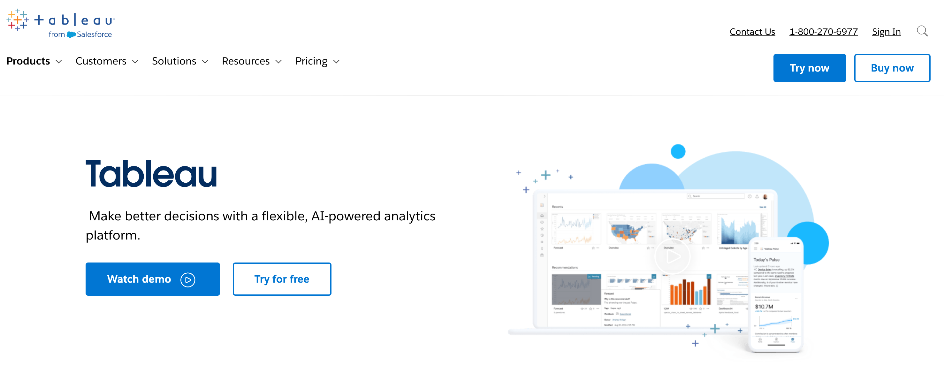
What is Tableau? But first, we need to get the software installed

Slide 3
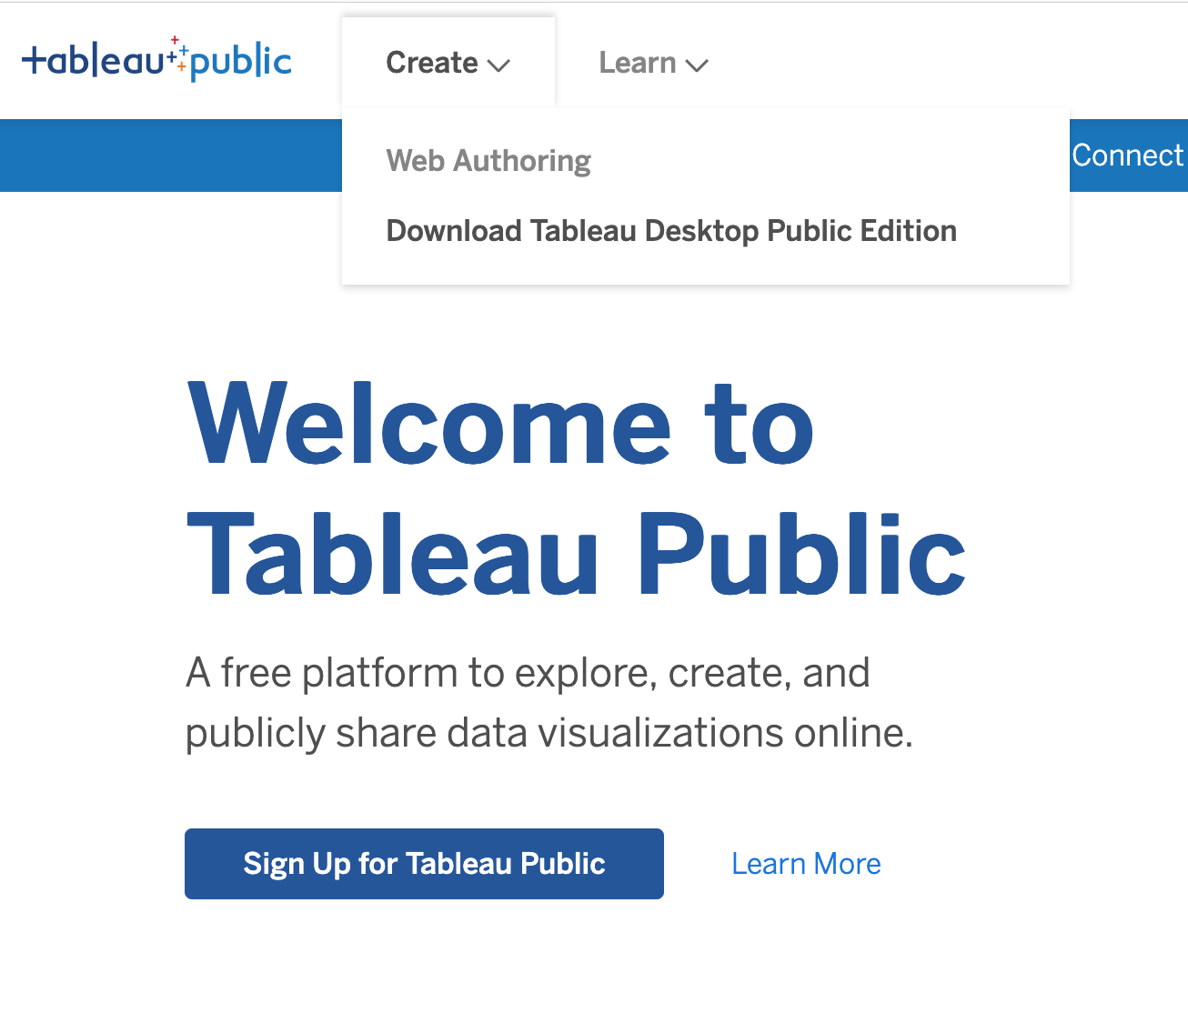
public.tableau.com
Steps:
Download Tableau Desktop Public Edition
Sign Up for Tableau Public
Download the data
https://github.com/profSeeger/itag2025

Slide 4
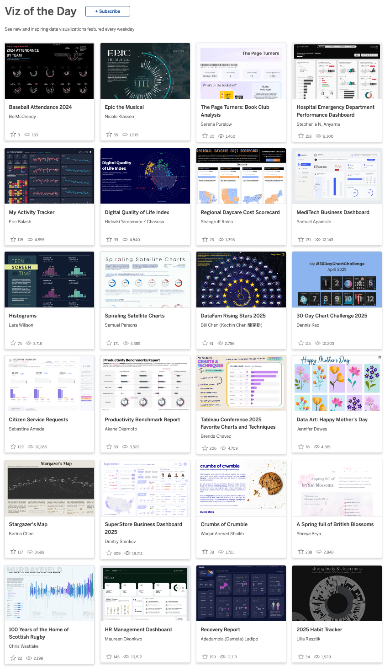
What is Tableau? Let’s Explore Some Vizzes
Viz of the Day https://public.tableau.com/app/discover/viz-of-the-day
Butterflies …
https://public.tableau.com/app/profile/usda.data.viz.community.of.practice/viz/SubmissionD/Dashboard1
Butterfly Effect (Dashboard layout
https://public.tableau.com/app/profile/sparsonsdataviz/viz/TheButterflyChartEffect/TheButterflyChartEffect
Random Viz Search ???

Slide 5
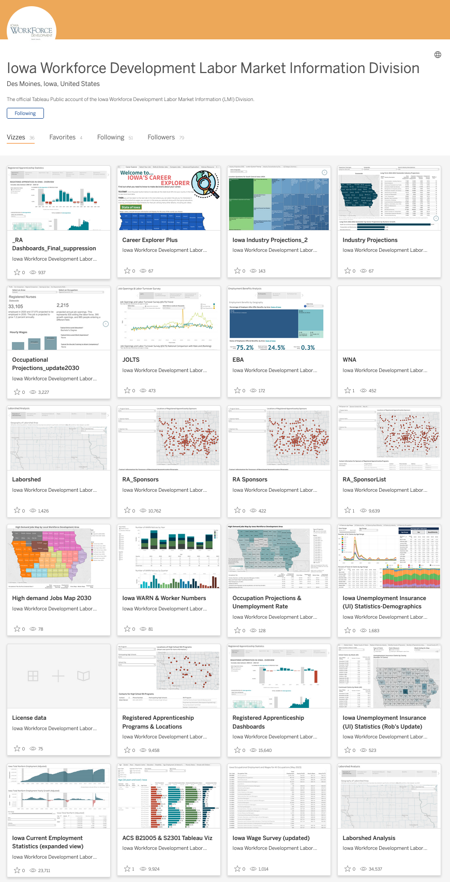
Iowa Workforce Development
https://public.tableau.com/app/profile/iowalmi/vizzes

Slide 6
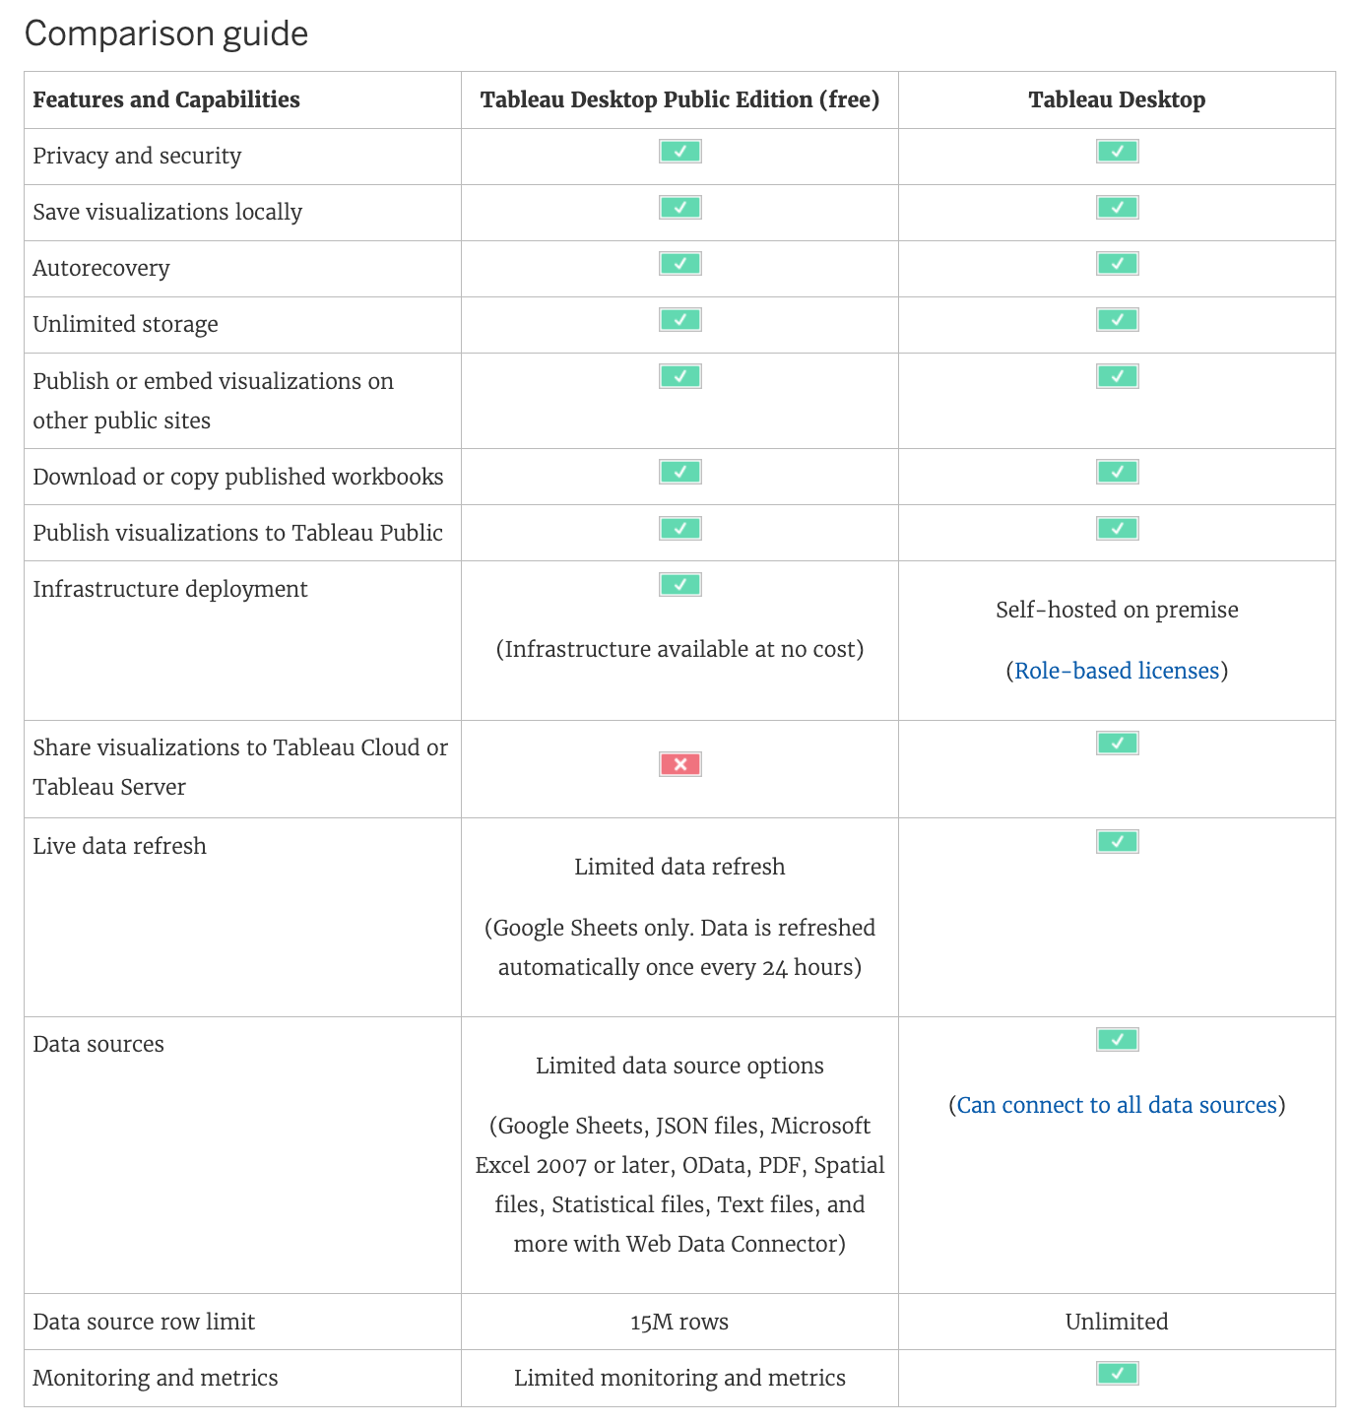
Product Comparison Guide

Slide 7
Product Comparison Guide

Slide 8
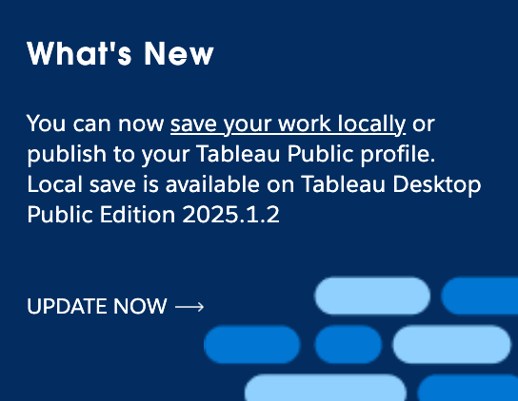
Tableau Desktop Public 2025.1.2
Save
Local File

Slide 9
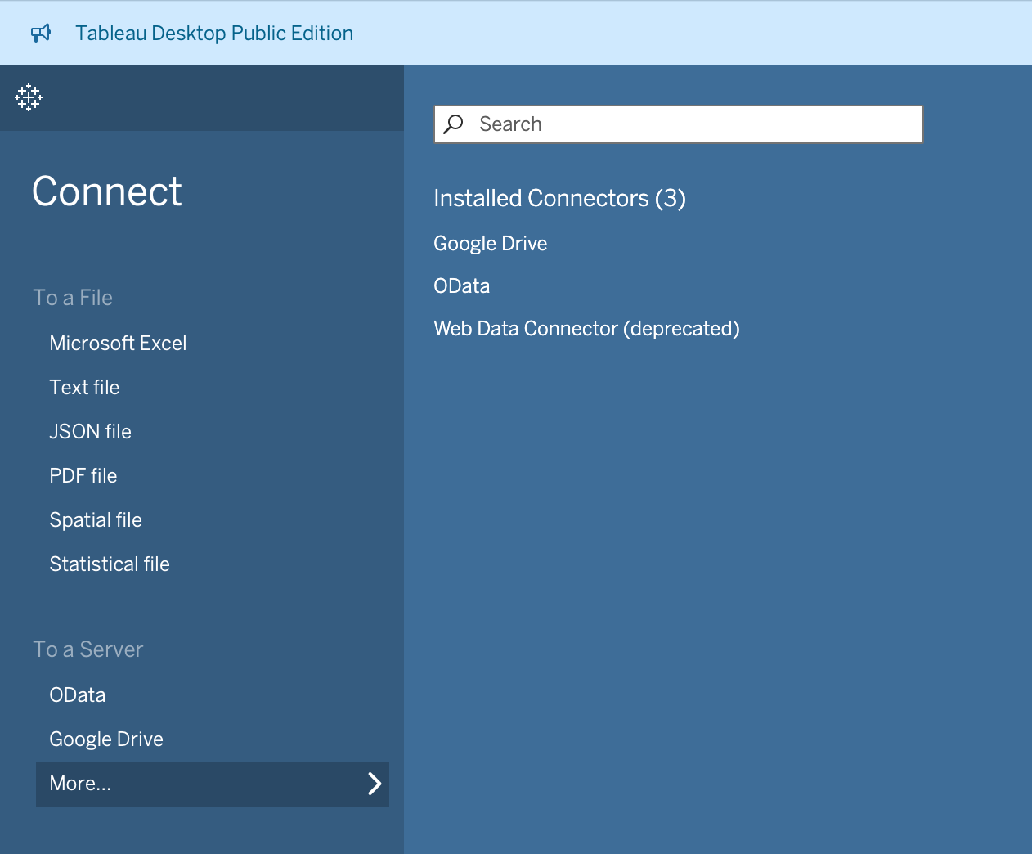

Slide 10
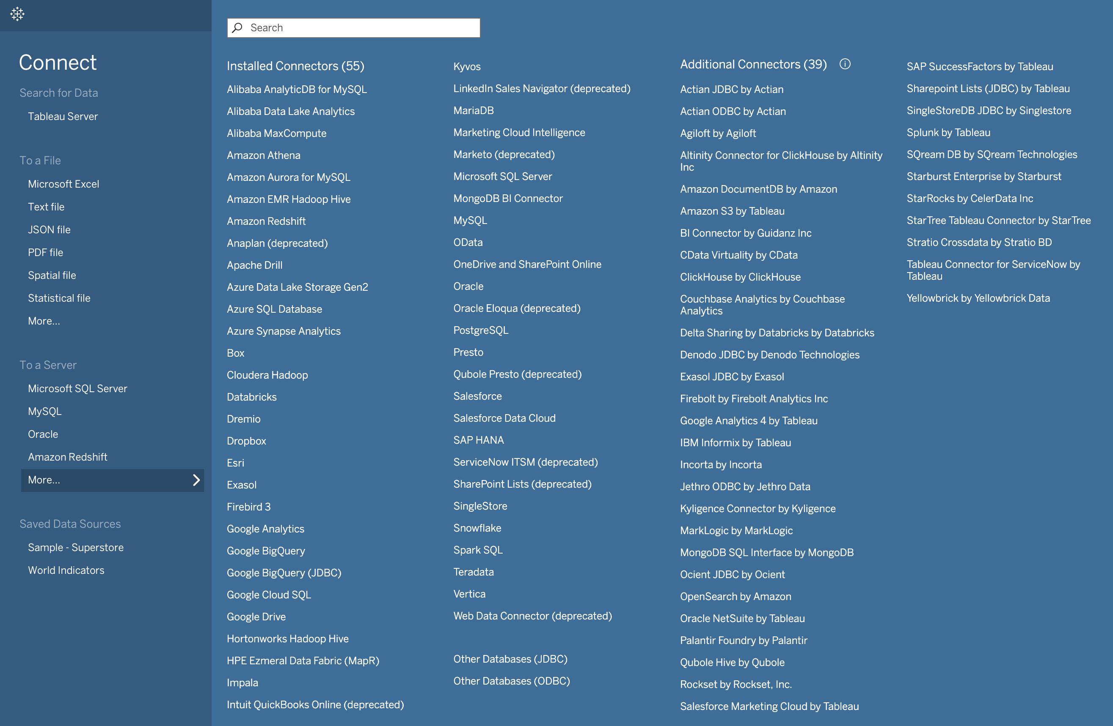

Slide 11
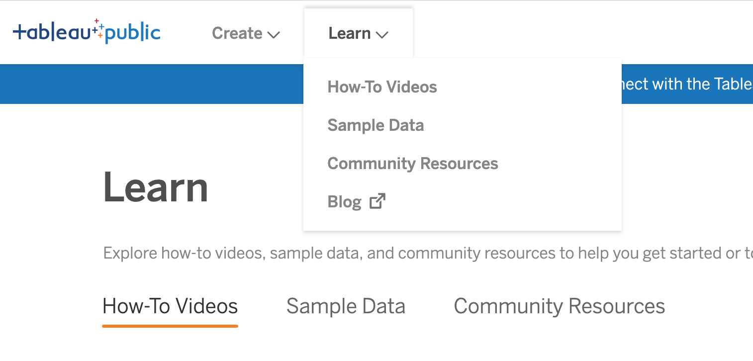
Learning Resources

Slide 12
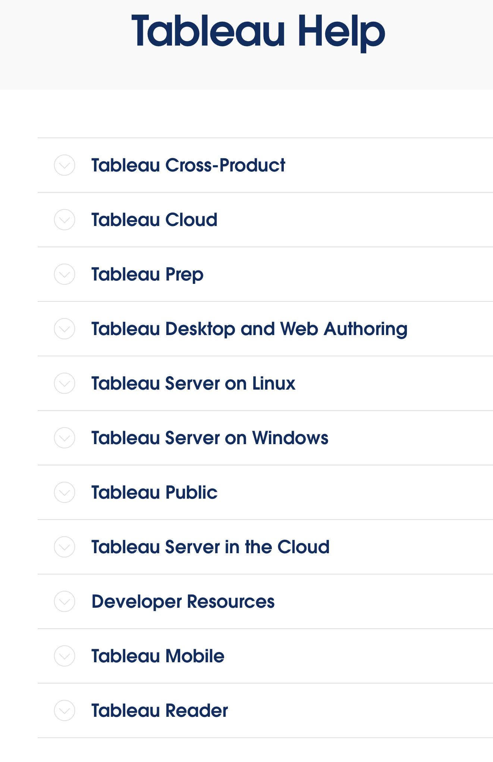
Tableau Help
help.tableau.com

Slide 13
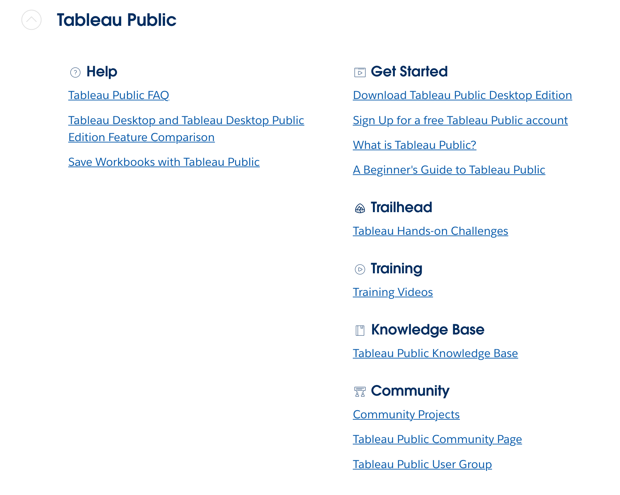
Learning Resources

Slide 14
Tableau Help
help.tableau.com

Slide 15
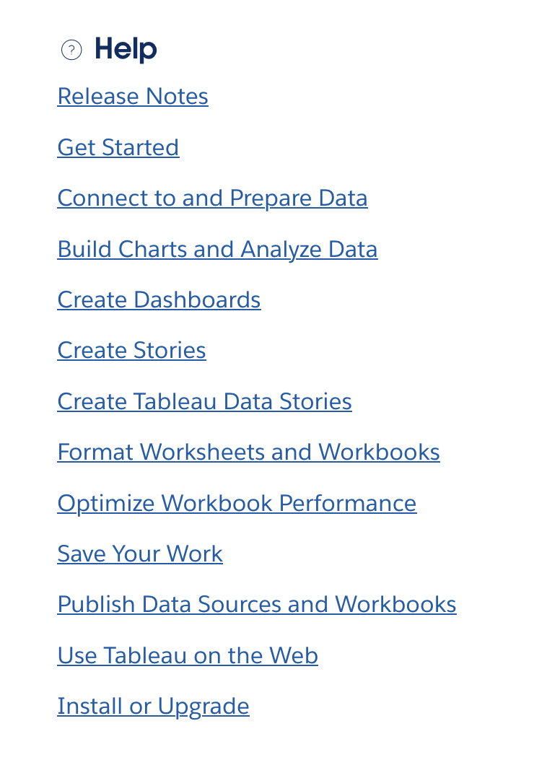
Tableau Help

Slide 16
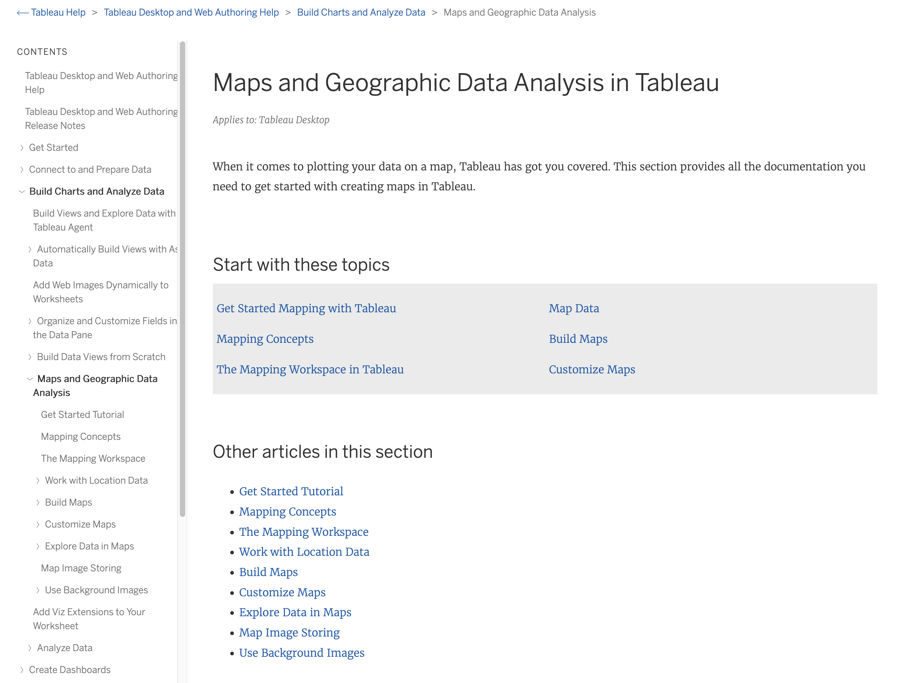
Tableau Map Help

Slide 17
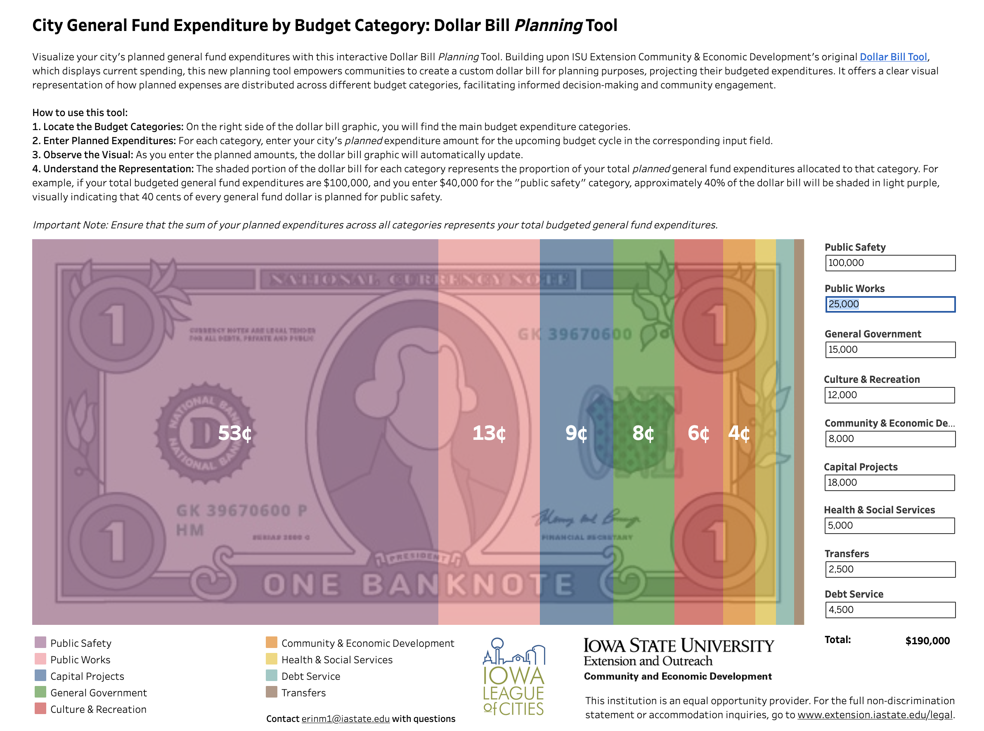
Some of our projects:
The Dollar Tool

Slide 18
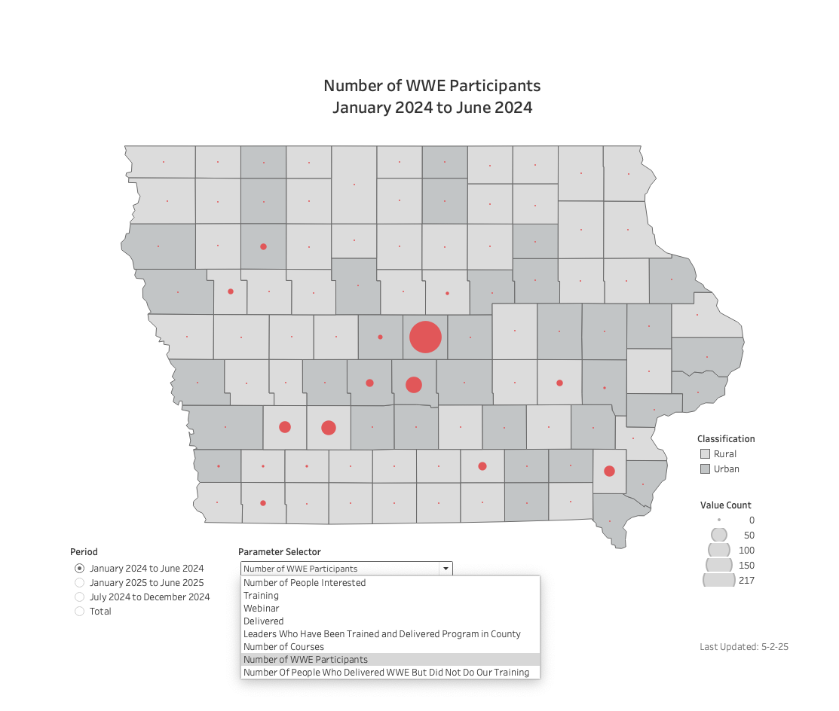
Some of our projects:
Tracking program participation

Slide 19
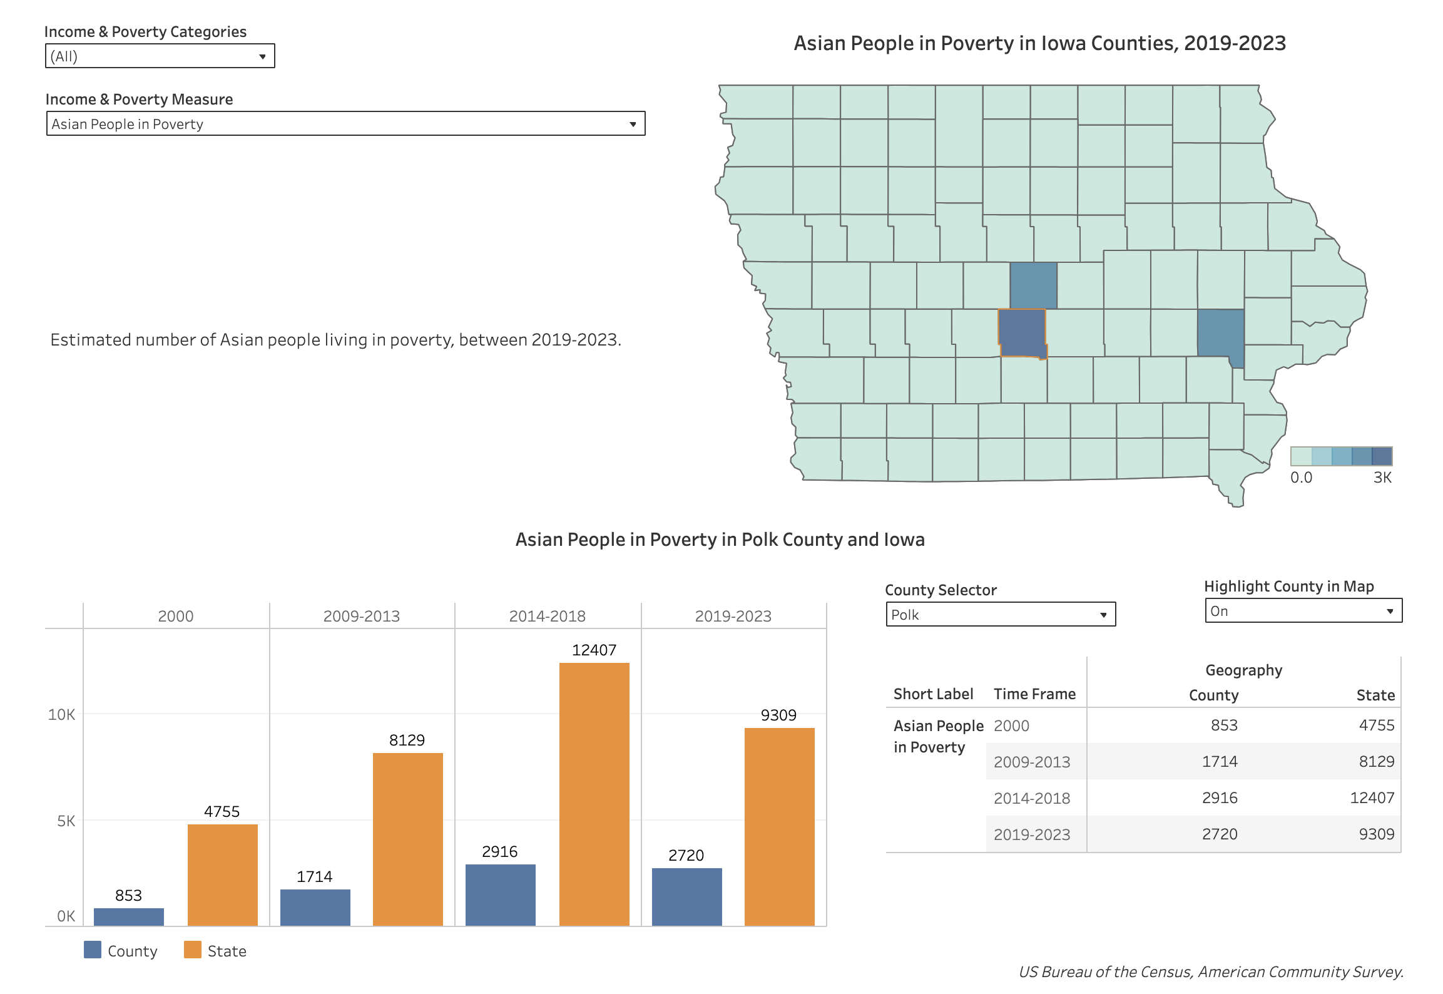
Some of our projects:
Income and Poverty Explorer

Slide 20
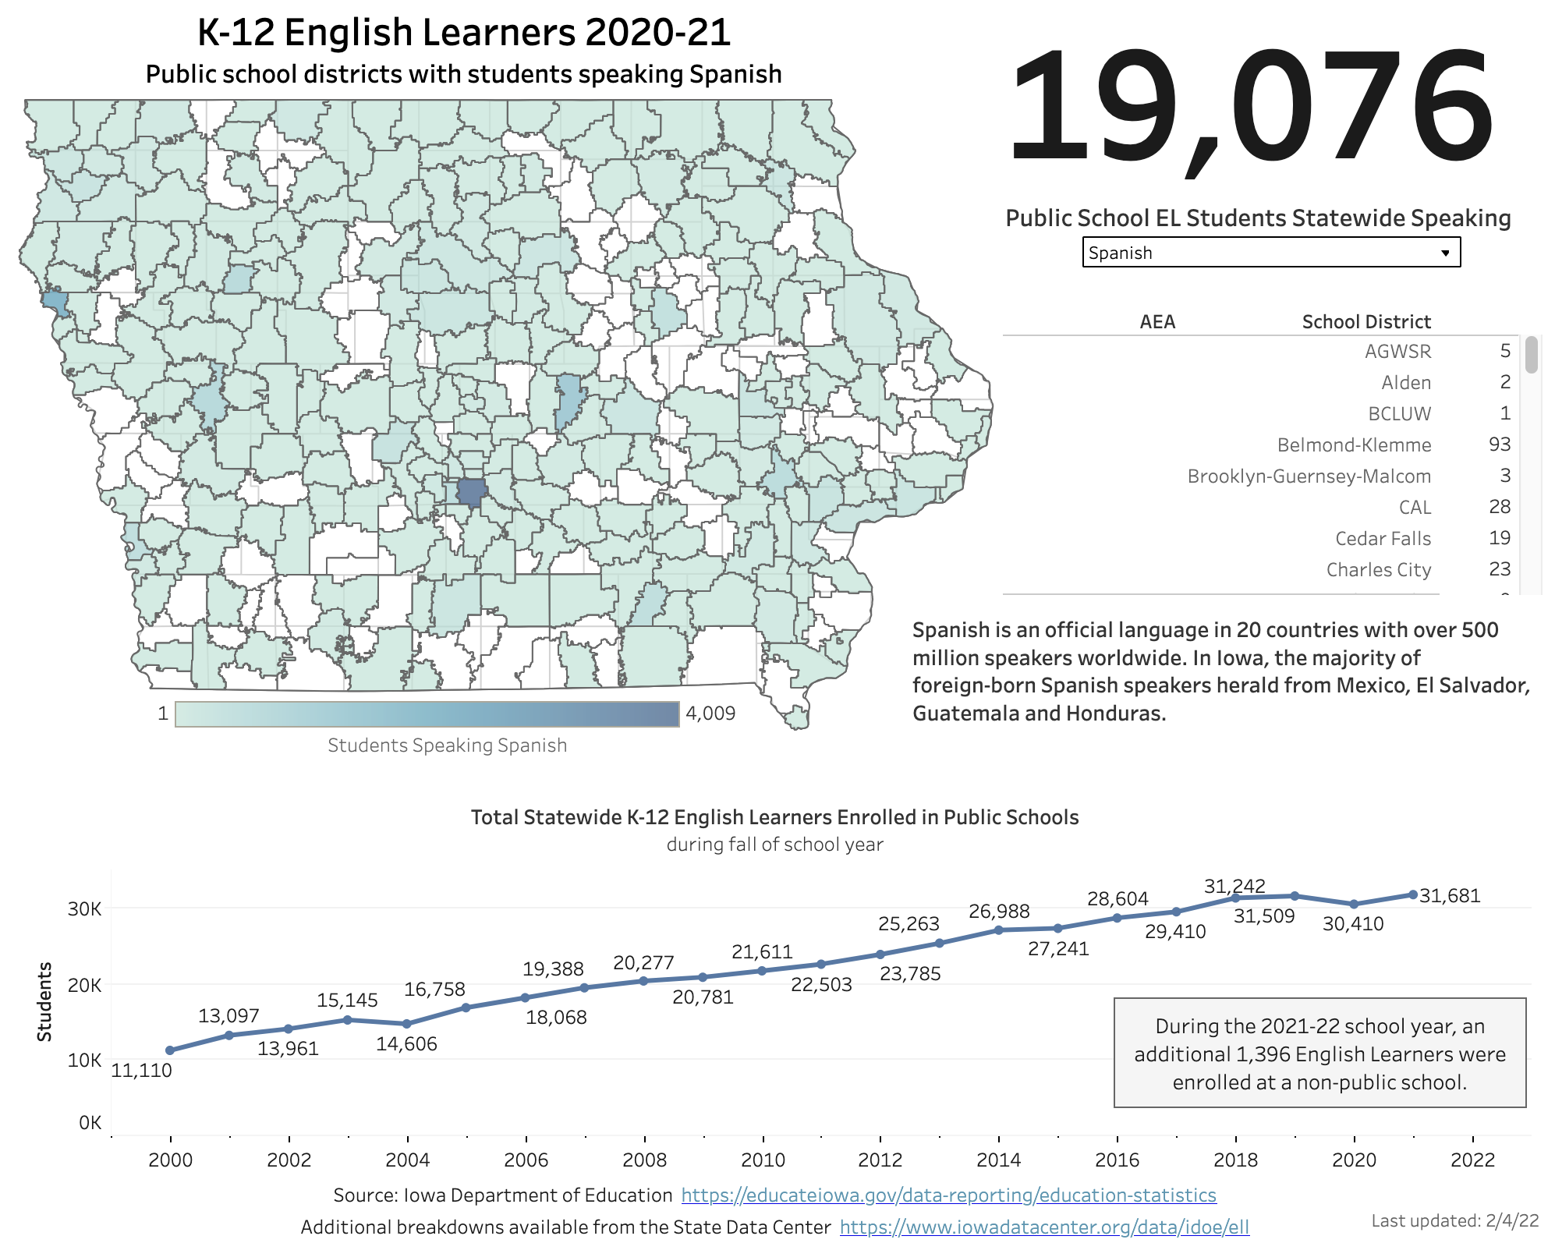
Some of our projects:
English Learners

Slide 21
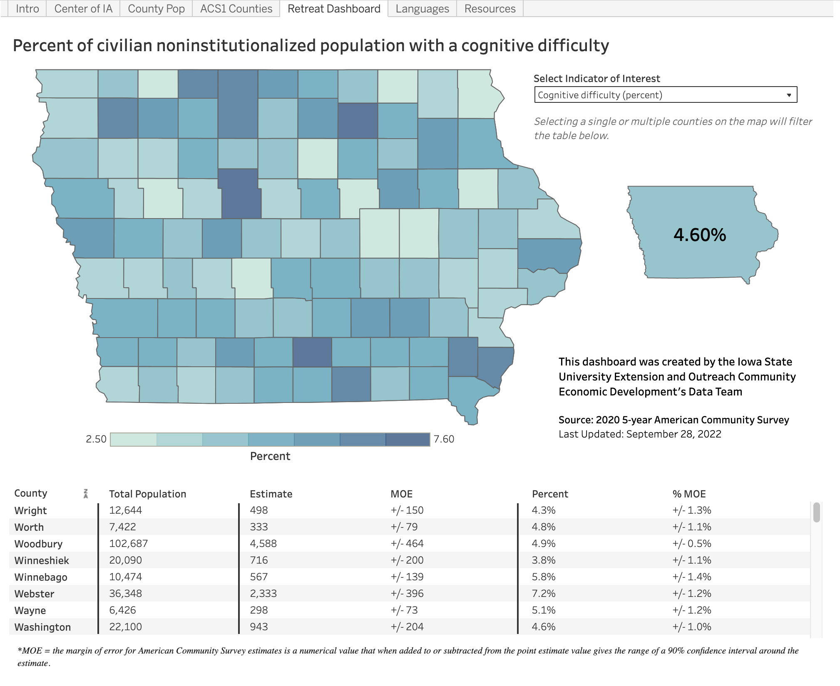
Some of our projects:
Meeting Dashboard

Slide 22
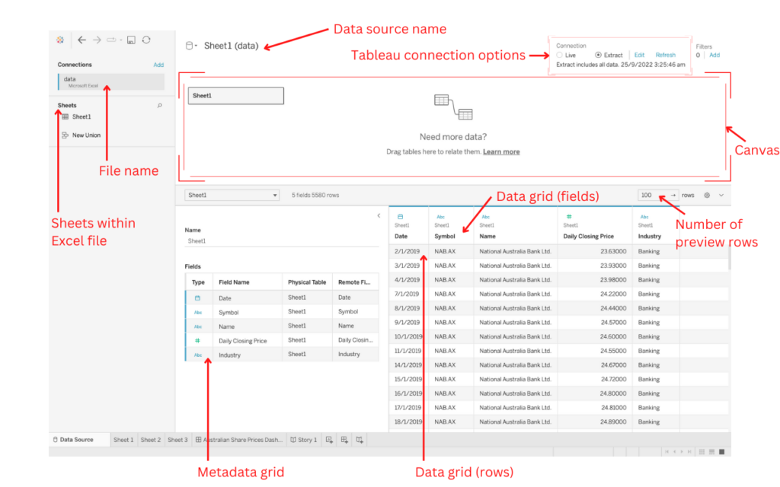
Data Source Interface Source: Tableau Help

Slide 23
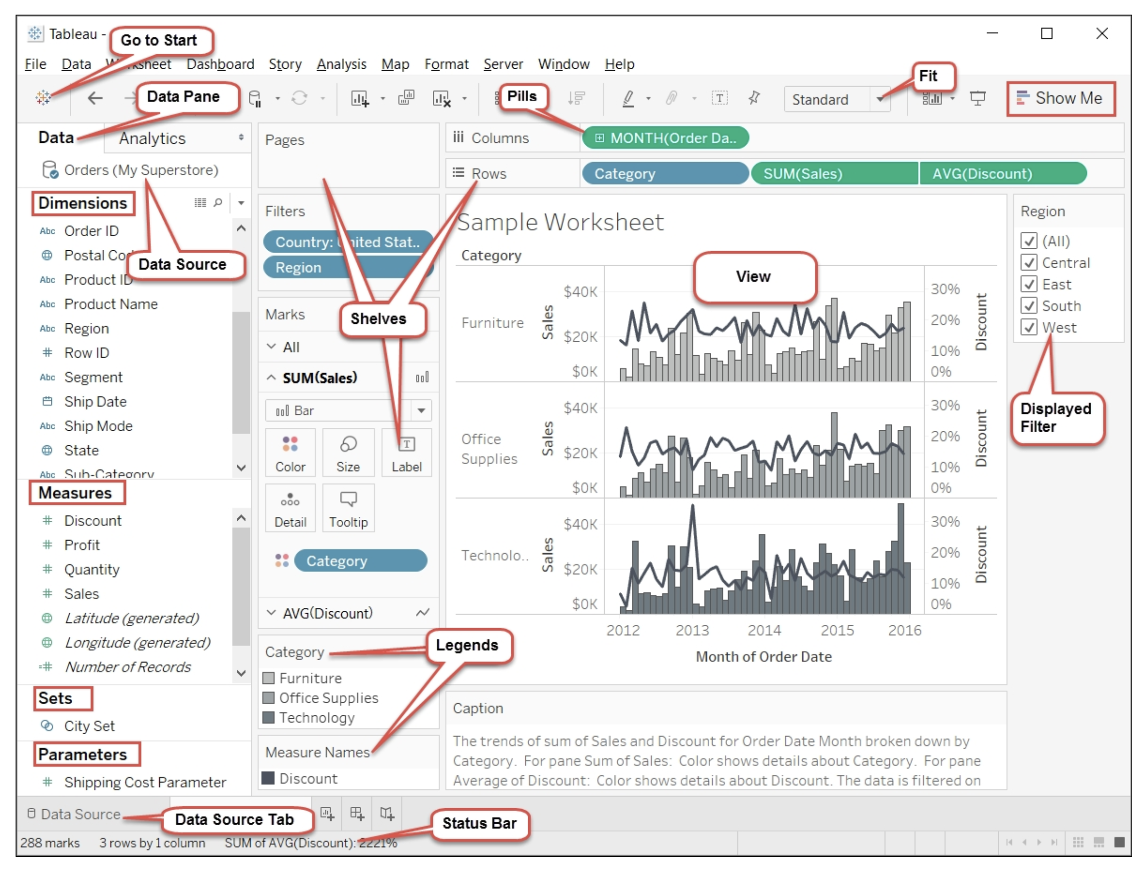
Worksheet Design Interface Source: O’Reilly Mastering Tableau by David Baldwin

Slide 24
Data Categories: Dimension vs Measures Blue and Green Pills
Dimensions are qualitative, meaning they can't be measured but are instead described. Dimensions are often things like city or country, eye color, category, team name, etc. Dimensions are usually discrete.
Measures are quantitative, meaning they can be measured and recorded with numbers. Measures can be things like sales, height, clicks, etc. In Tableau Desktop, measures are automatically aggregated; the default aggregation is SUM. Measures are usually continuous.

Slide 25
Data Categories: Dimension vs Measures Blue and Green Pills
Discrete means individually separate or distinct. Toyota is distinct from Mazda. In Tableau Desktop, discrete values come into the view as a label and they create panes.
Continuous means forming an unbroken, continuous whole. 7 is followed by 8 and then it's the same distance to 9, and 7.5 would fall midway between 7 and 8. In Tableau Desktop, continuous values come into the view as an axis.
Dimensions are usually discrete, and measures are usually continuous. However, this is not always the case. Dates can be either discrete or continuous.

Slide 26
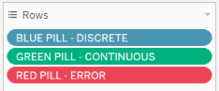
A shorter answer …
Dimensions usually cannot be aggregated (summed, averaged etc), whereas measures can be.

Slide 27
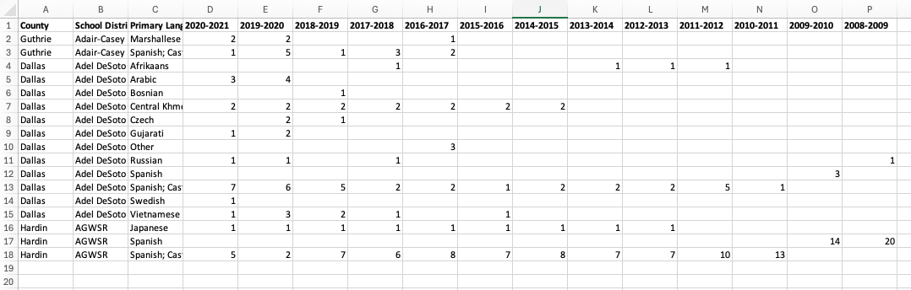
Wide vs Long (Tall Data)
Wide

Slide 28
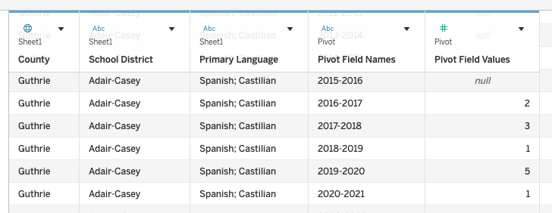
Wide vs Long (Tall Data)
Tall

Slide 29
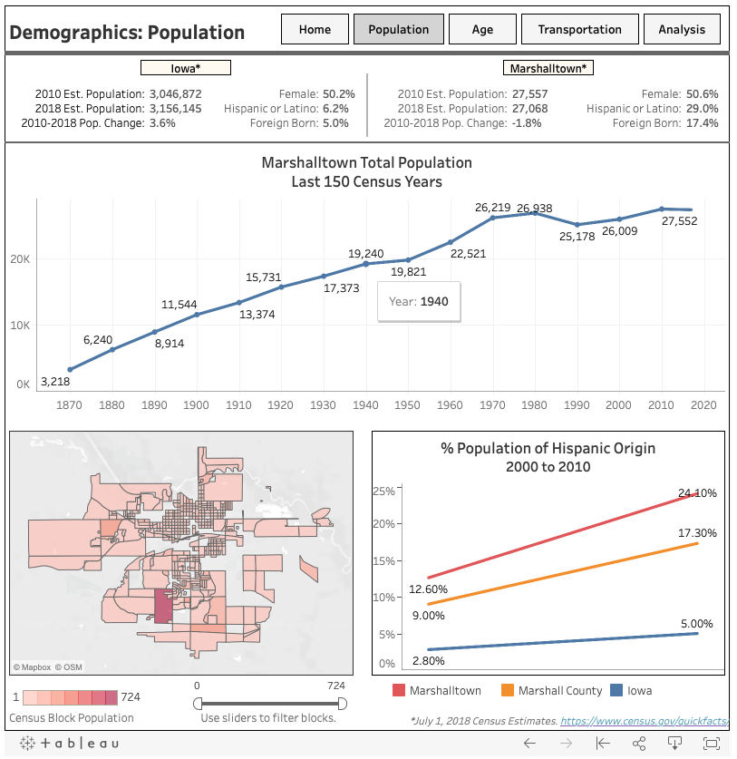
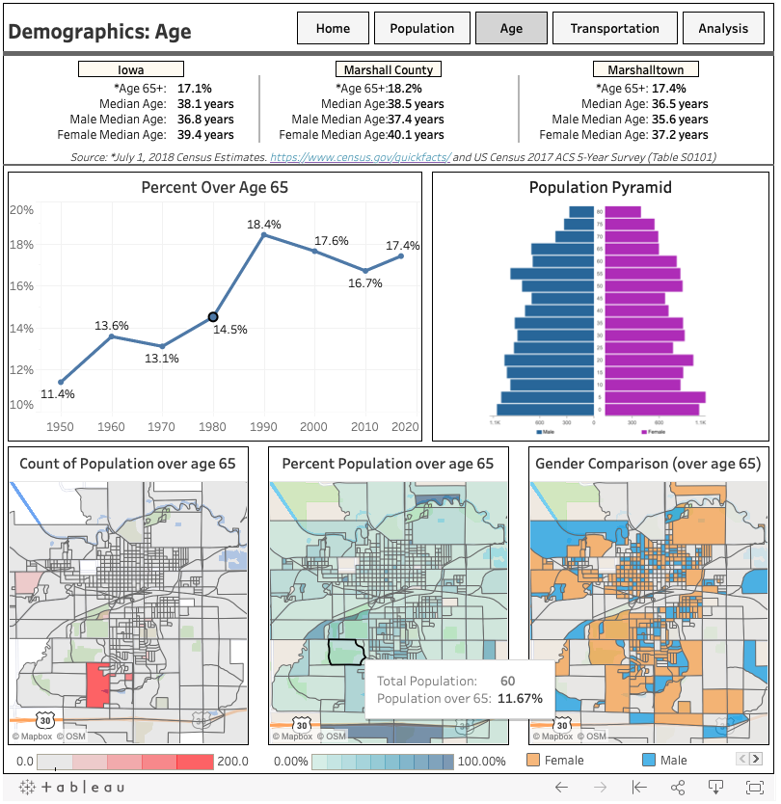

Slide 30
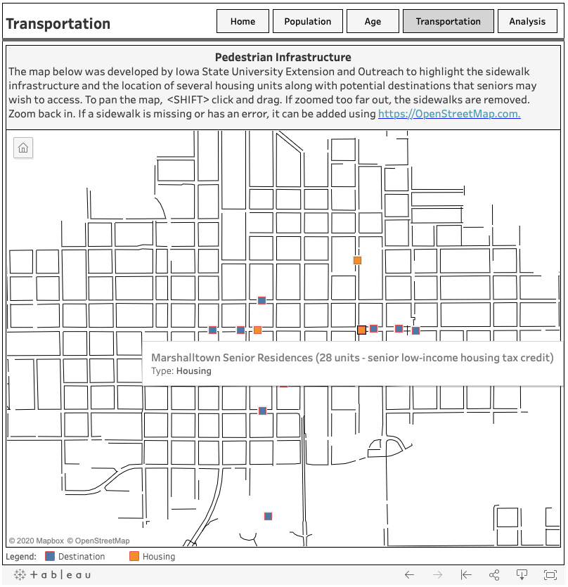
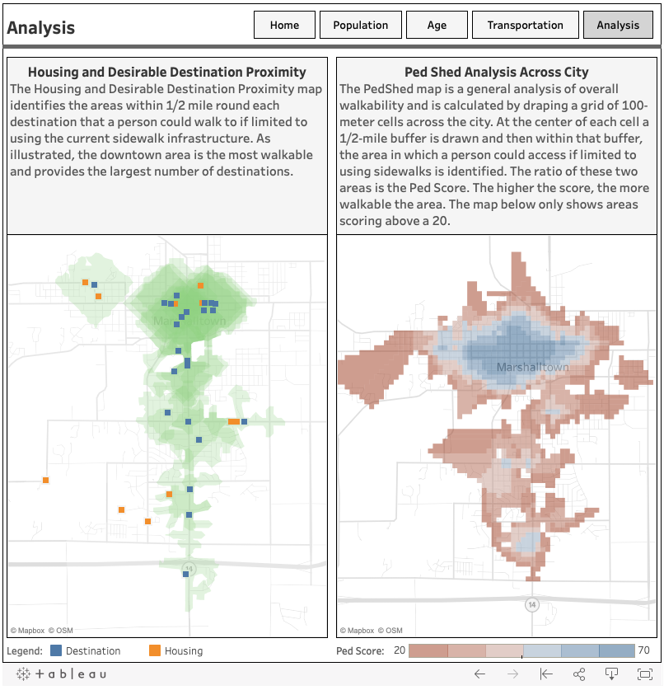

Slide 31
Hands on Demo Time!
https://github.com/profSeeger/itag2025

Slide 32
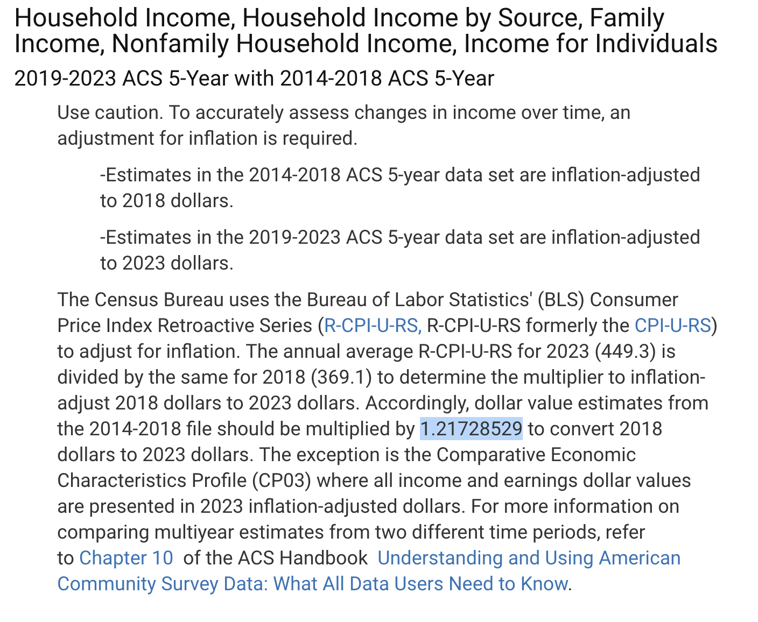
Inflation Conversion 1.21728529

Slide 33

Workshop Eval

